Slide 1
Embedded C Programming
Efficient Embedded Systems
Nitin Chandrachoodan, IIT Madras

Slide 2
Efficiency

Slide 3
Efficiency
Constrained resources need to be used with care
Make the best use of resources
Efficiency: Maximize system performance while minimizing resource utilization

Slide 4
Interrupts and Polling

Slide 5
Status Check
Problem:
Check if a condition is satisfied
Do something if it is - else do something else
Example: button press, data present in buffer, x seconds passed since last check etc.

Slide 6
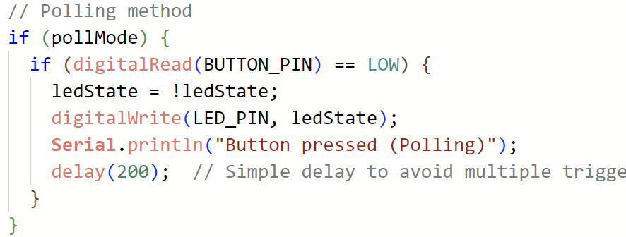
Polling
Repeatedly check value
If condition satisfied then react
Else keep checking

Slide 7
Polling
Repeatedly check value
If condition satisfied then react
Else keep checking
Problem:
Busy waiting - CPU cannot do anything else
Uses lot of power

Slide 8
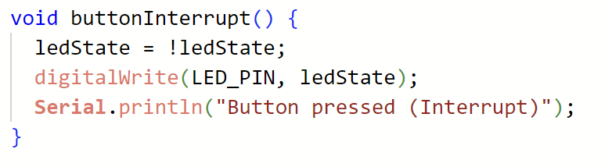
Alternative - Interrupt
Register an interrupt with CPU
Interrupt service routine - based on “vector” table
CPU can do anything else, or even go to sleep
Requires some hardware support

Slide 9
Polling vs Interrupts
Polling - Advantages
Simple to implement
Deterministic timing
Disadvantages
CPU busy
Potential for missed events
Check loop can get complicated if multiple events to be polled for

Slide 10
Polling vs Interrupts
Polling - Advantages
Simple to implement
Deterministic timing
Disadvantages
CPU busy
Potential for missed events
Check loop can get complicated if multiple events to be polled for
Interrupts - Advantages
Efficient CPU usage
Low-power modes possible
Responsive to events
Disadvantages
More complex code
Harder to debug
Complicates priority

Slide 11
Polling vs Interrupts - Use Cases
Polling
Non-time critical - simpler code
Low frequency of event occurrence
Limited hardware resources - interrupt lines
Deterministic timing
Example: logging temperature sensor at regular intervals
Interrupts
Immediate attention required
External / Unpredictable events
Short duration events that could be missed by polling
CPU efficiency
Example: motion sensor to detect intrusion

Slide 12
Direct Memory Access (DMA)

Slide 13
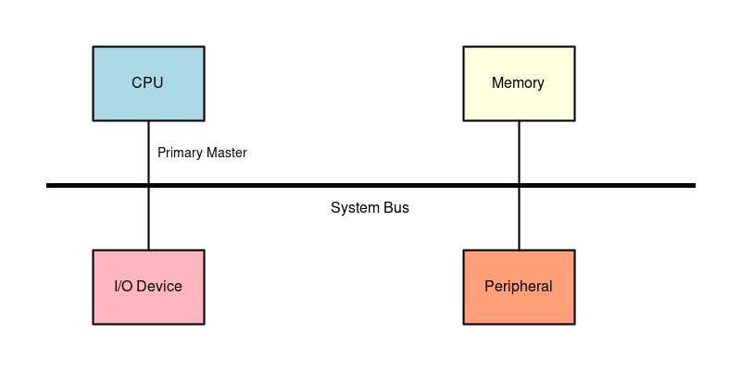
CPU System Bus and Peripherals

Slide 14
Problem
CPU involved in all data transfers
Examples:
UART receives data - copy to buffer - CPU
WiFi needs to transmit - CPU copies data to TX buffer
Video display - CPU copies data to framebuffer
CPU is only transferring data
No computation involved

Slide 15
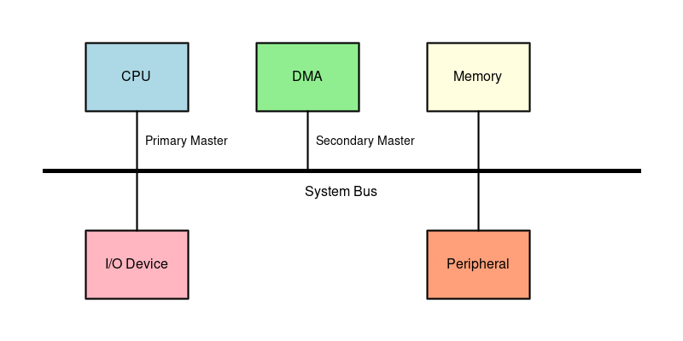
Secondary Bus Master

Slide 16
Memory-only bus master
Generate addresses and control signals
Read from an address, Write to an address
Maximum utilization of resource:
no computation involved
Only data transfer
Burst transactions
Copy large chunks of data, not just single bytes
Direct Memory Access (DMA)

Slide 17
DMA Configuration
DMA itself has a “slave” interface to CPU
CPU can “configure” a DMA transfer
Start address
Length of transfer
Destination address
DMA takes over generating addresses for transfer
CPU can do other work in the meantime
What if CPU also wants to access memory at the same time?

Slide 18
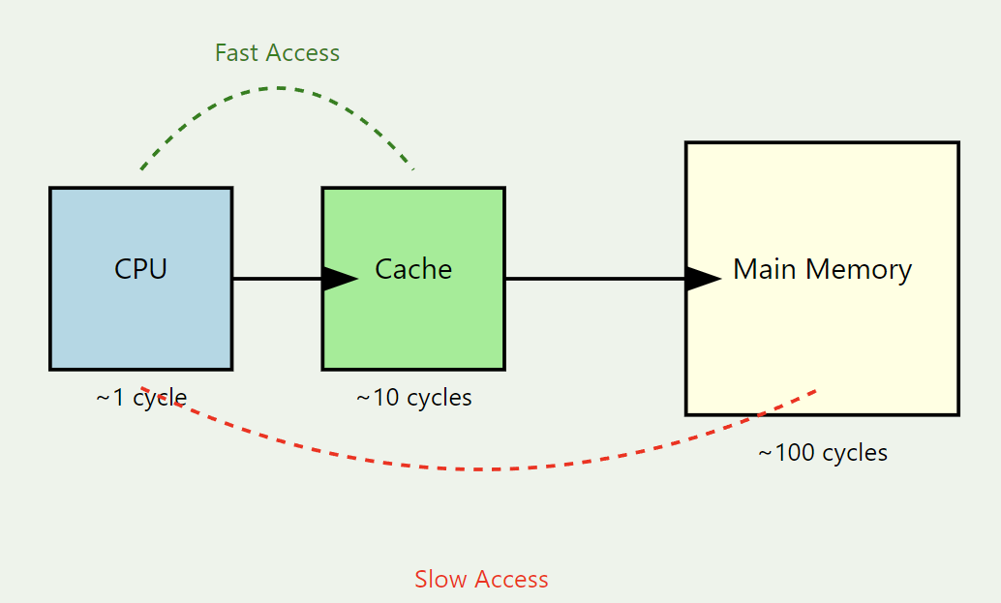
A word about cache memory

Slide 19
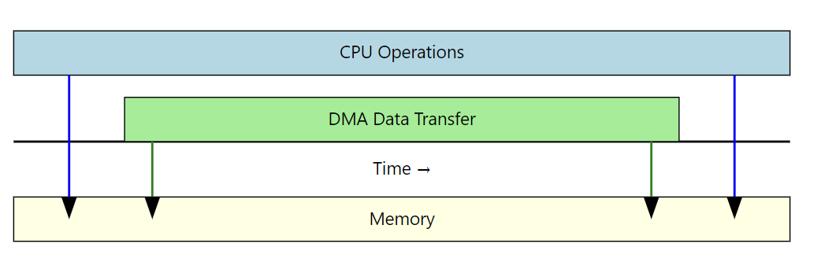
Concurrent Operation
CPU can operate from cache memory
CPU is only performing arithmetic without Load/Store

Slide 20
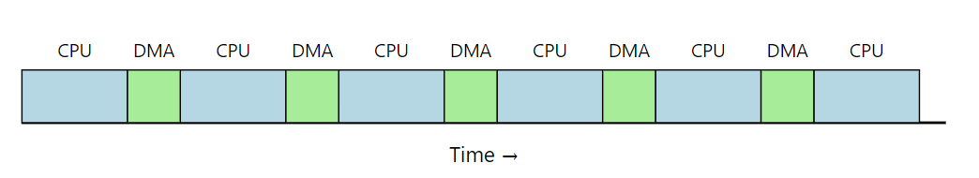
Cycle Stealing DMA
DMA “requests” bus control
Arbiter “grants” bus control to DMA for short duration
Transfer few words
Return control to CPU
Allows CPU to continue doing work, but DMA also transfers data
Use cases - real-time transfers:
Audio
Network
Disk read/write

Slide 21
Interrupts and DMA
DMA should NOT be run inside an ISR
Generally takes a long time - ISR meant to be fast
Instead: DMA can generate an interrupt
Signal completion of transfer
CPU can be in deep sleep / low power mode if needed
Wake up on DMA interrupt
Initiate next transfer or process current transfer

Slide 22
Power

Slide 23
Power in Electronic Systems
Dynamic
Switching of voltage from 0 to Vdd and back
Depends on activity
More transistors/gates => more complex circuit => more power
Higher frequency => more power
Also short-circuit currents
Static
Leakage: current flows even when transistors are “off”
Battery internal leakage
Usually small, but always present
Power gating, sleep transistors etc.

Slide 24
Components of an Embedded System
Core: CPU, on-chip peripherals, clock (can be major consumer)
I/O: pins generally larger, more capacitance => more power
Memory: RAM, embedded ROM, DRAM (refresh)
Peripherals: Sensors, Actuators, Communication…
Display: Often very large power sink: refresh rates, brightness…
Power management circuitry: regulators (LDO, switching), charging
Low power uC by itself not sufficient: this is system-level design

Slide 25
CPU power modes
Active: highest power, highest frequency, quick response and compute
Idle: typically low power - NOP
Sleep: shut down many peripherals, program counter stops till woken up
Interrupt or other wake-up mechanism
Leakage power still present
Specialized ultra-low-power modes may be available

Slide 26
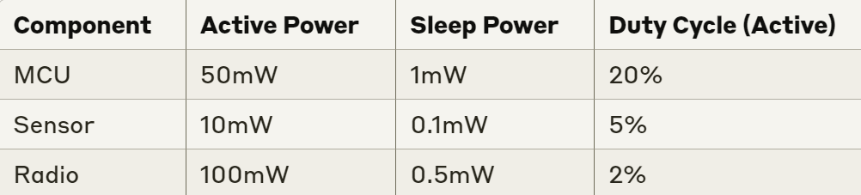
Example: Power estimation
Individual power estimates from datasheets
Duty cycle from program profile

Slide 27
Example: Power estimation
MCU: 50 * 0.2 + 1 * 0.8 = 10.8
Sensor: 10 * 0.05 + 0.1 * 0.95 = 0.595
Radio: 100 * 0.02 + 0.5 * 0.98 = 2.49
Total power:
10.8 + 0.595 + 2.49 = 13.885 mW
~ 14 mW (these are estimates at best):
10-15 mW?

Slide 28
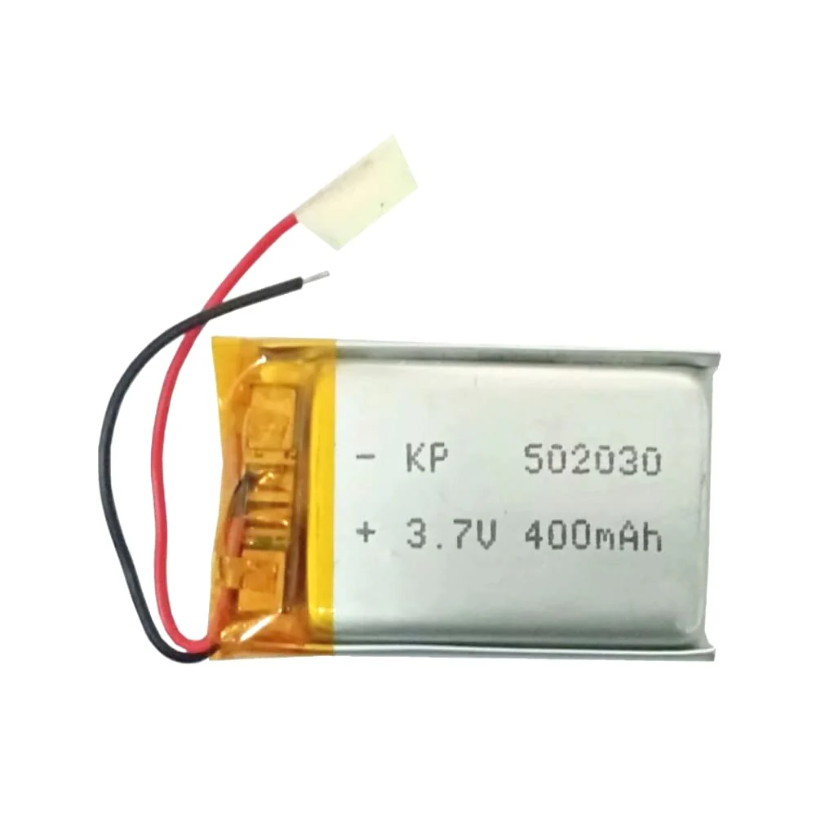
Example: Lifetime estimation
Battery capacity: 400mAh at 3.7V
1480 mWh
approximately 1 hour at 1.48 W consumption
approximately 1000 hr at 1.48 mW
13.885 mW average power
106.6 hours (way too much precision)
~ 100 hours estimate reasonable

Slide 29
Control Power
Circuit Centric
Choice of components
Low power modes
Display tech
Gating:
Clock-gate
dynamic freq scale
Power-gate, peripheral shutoff
Power supply
Efficient regulators, charging
Software Controlled
Optimize I/O
Reduce sensor reading
Batch communication
More efficient algorithms
FFT vs DFT, shift vs mult
Memory
Reduce dynamic allocation
Interrupts
Better than polling
Reduce rate

Slide 30
Optimization

Slide 31
Optimization
Definition: “an act, process, or methodology of making something (such as a design, system, or decision) as fully perfect, functional, or effective as possible.”
What?
Speed
Area (memory)
Power (battery life)
How?

Slide 32
Algorithmic Optimization
Description: Choosing the most efficient algorithms for your tasks.
Example: Using a more efficient sorting algorithm (e.g., quicksort vs. bubble sort vs. insertion sort).
Context in Embedded Systems: Reducing computational complexity to save CPU cycles and power.

Slide 33
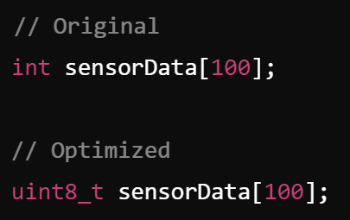
Memory Optimization
Description: Efficient use of memory resources, both RAM and flash.
Example: Using smaller data types, optimizing data structures, minimizing stack usage.
Context in Embedded Systems: Embedded systems often have limited memory, so efficient memory usage is crucial.

Slide 34
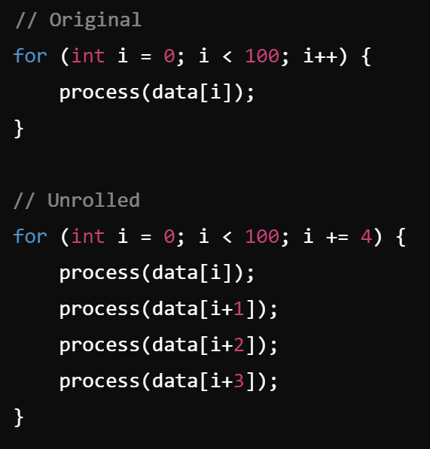
CPU Optimization
Description: Enhancing the CPU utilization by writing more efficient code.
Example: Loop unrolling, using fixed-point arithmetic instead of floating-point.
Context in Embedded Systems: Ensures that the CPU spends less time on tasks, improving overall system performance.

Slide 35
Compilers Role in Optimization
Compiler flags:
optimize for speed, area (usually)
Simplify computations, eliminate redundant/dead code
Cache / memory layout aware optimization
Use of ISA specific instructions
More efficient use of hardware

Slide 36
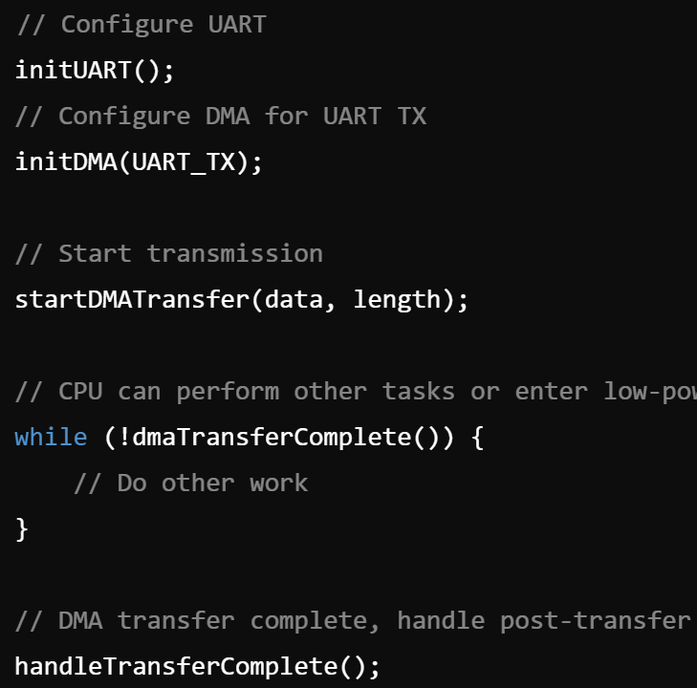
I/O Optimization
Description: Reducing the overhead of input/output operations.
Example: Using DMA to handle data transfers instead of CPU-driven I/O.
Context in Embedded Systems: Improves data throughput and reduces CPU load, allowing it to handle other tasks or enter low-power modes.

Slide 37
Power Optimization
Description: Reducing power consumption to extend battery life or reduce heat generation.
Example: Using sleep modes, reducing clock speeds, turning off unused peripherals.
Context in Embedded Systems: Critical for battery-operated devices or systems with thermal constraints.

Slide 38
Code Size Optimization
Description: Reducing the size of the compiled code to fit within the available flash memory.
Example: Removing unused code, using compiler optimizations, code refactoring.
Context in Embedded Systems: Many embedded systems have limited storage, so optimizing code size is essential.

Slide 39
Summary
Full system-level understanding is needed for optimization
Choices in one area can impact others:
small CPU => low power, but slow, so more compute needed
more peripherals => more power, but possibility of DMA or other transfers
Combination of circuit (component) and algorithm (software) choices

